Slide 1
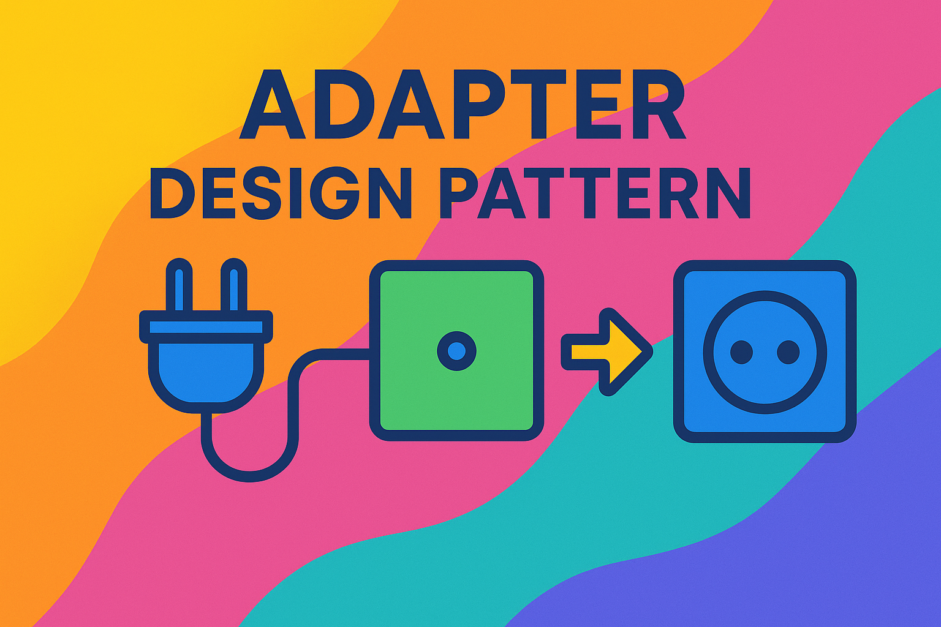

Slide 2
Creational (5)
Factory
Structural (7)
Adapter
Behavioral (11)
Chain Of Responsibility
Abstract Factory
Singleton
Prototype
Builder
Bridge
Composite
Decorator
Facade
Flyweight
Proxy
Command
Interpreter
Iterator
Mediator
Memento
Observer
State
Strategy
Template
Visitor

Slide 3
OOP Principals
Class
Object
Constructors
Inheritance
Method Overriding
Encapsulation
Interfaces
Abstractions
Polymorphism

Slide 4
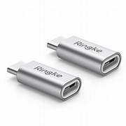
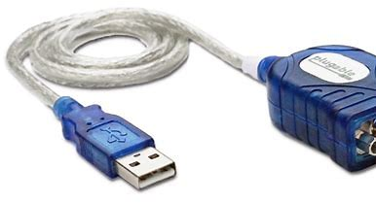
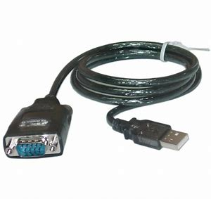
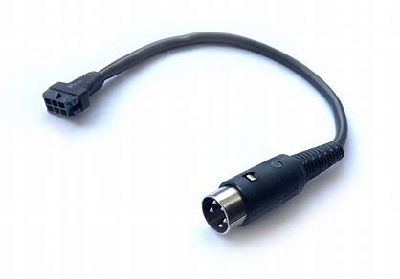
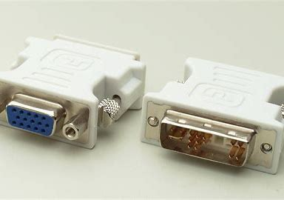
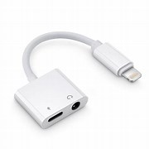

Slide 5
Adapter Design pattern is used to communicate between two non-compatible existing systems by providing a compatible interface.
Common term is wrapper class.

Slide 6
If the interfaces are incompatible, why we can't change them.
Why we can’t change the client so that is compatible with the web service.

Slide 7
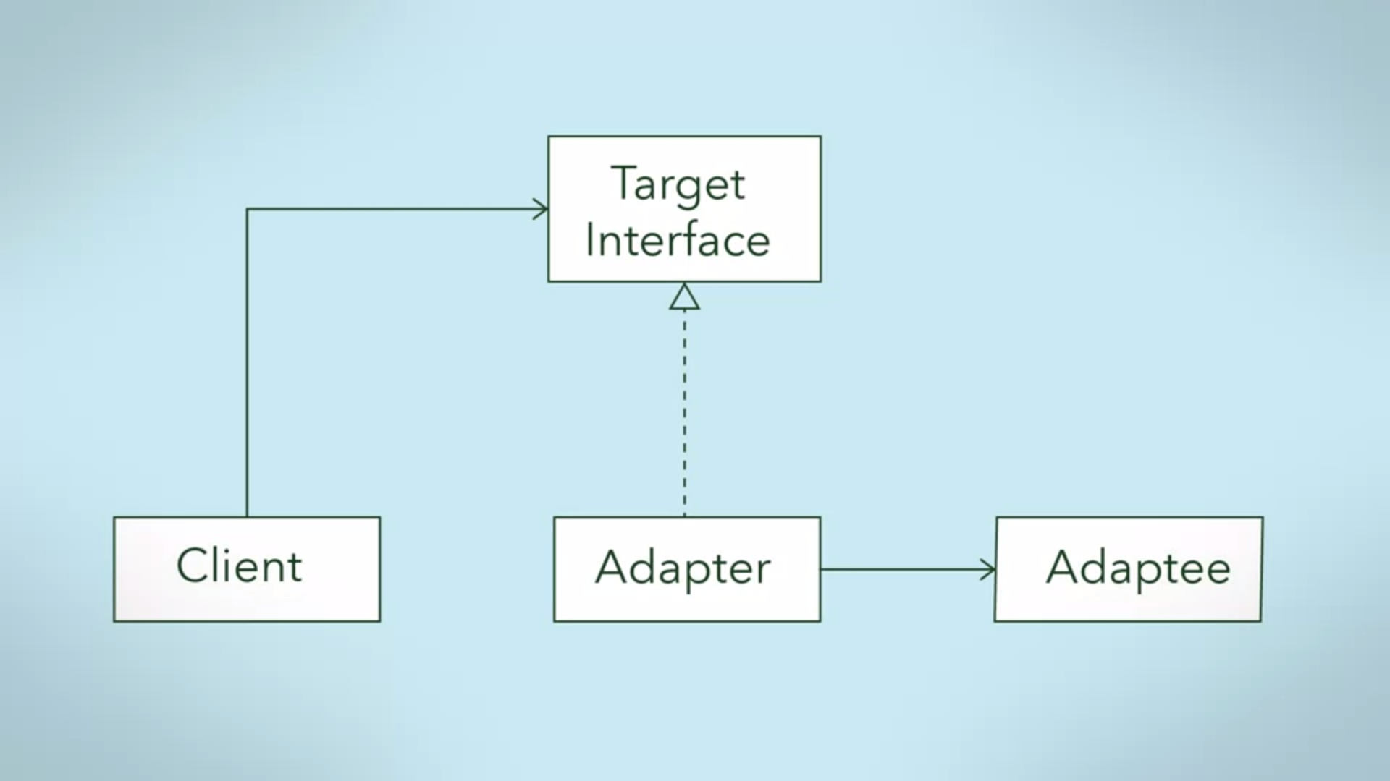

Slide 8
Implementations
Third party libraries
System Integration
Web Services
System Upgrades

Slide 9
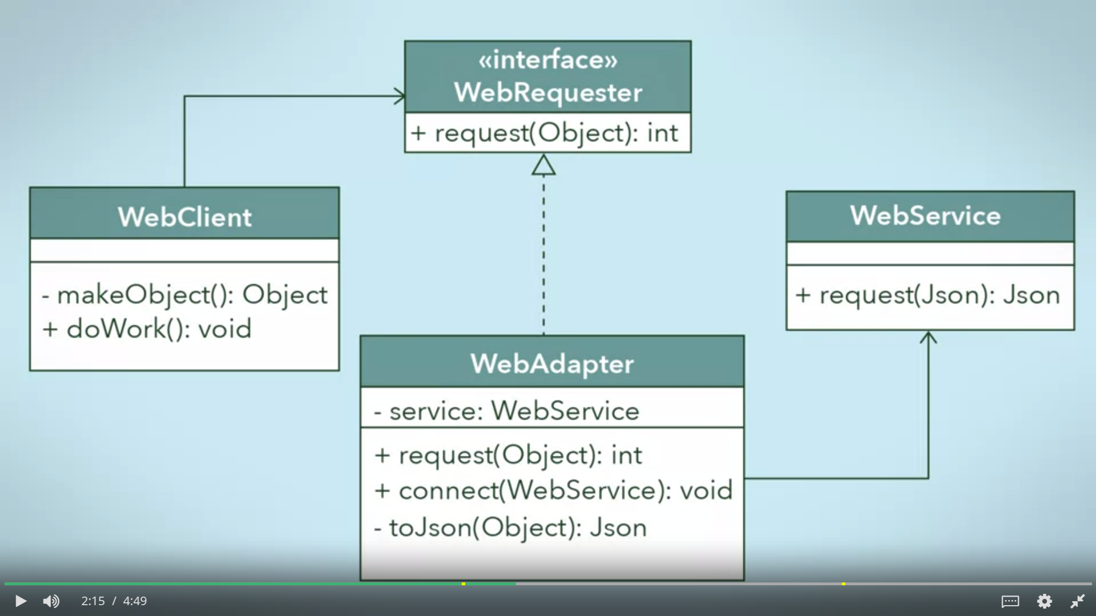

Slide 11
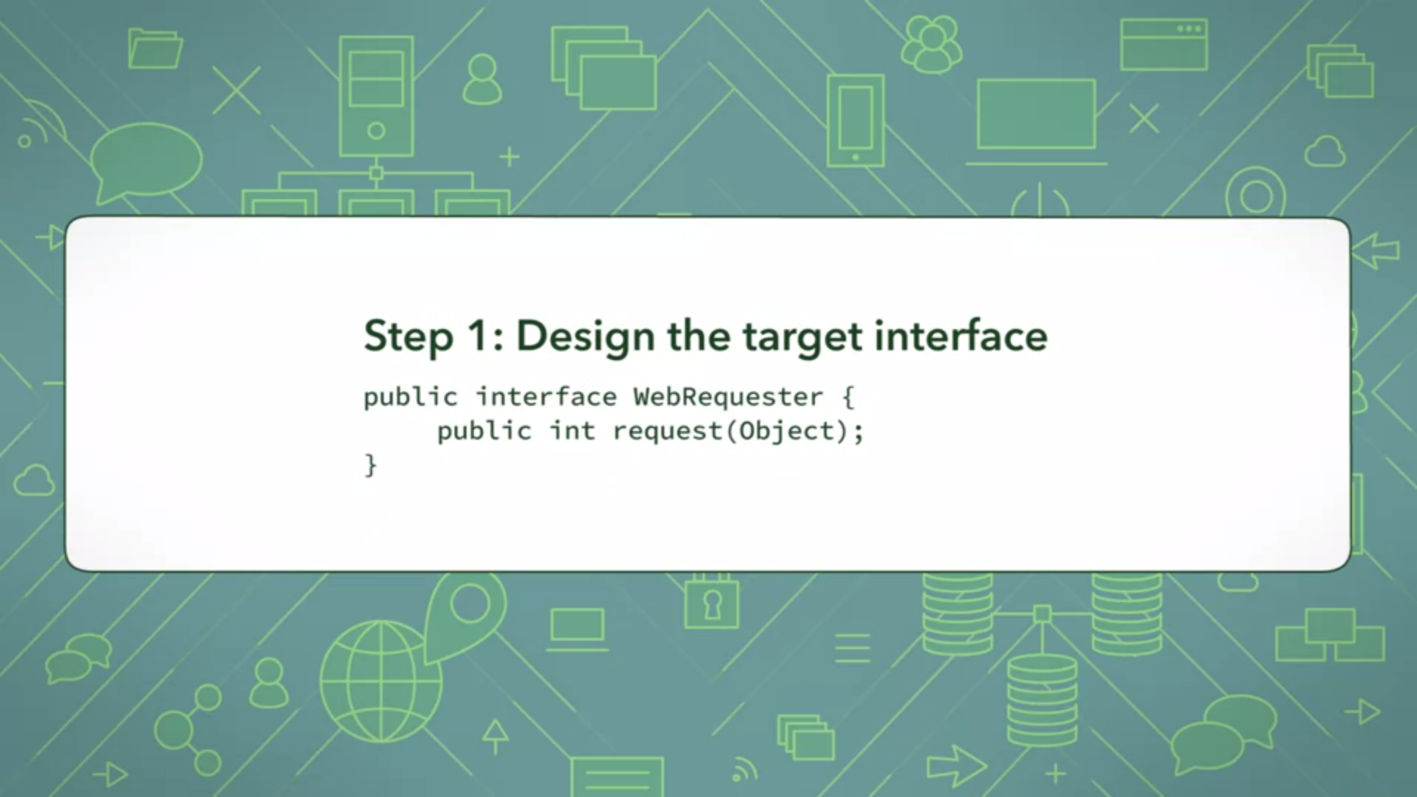

Slide 12
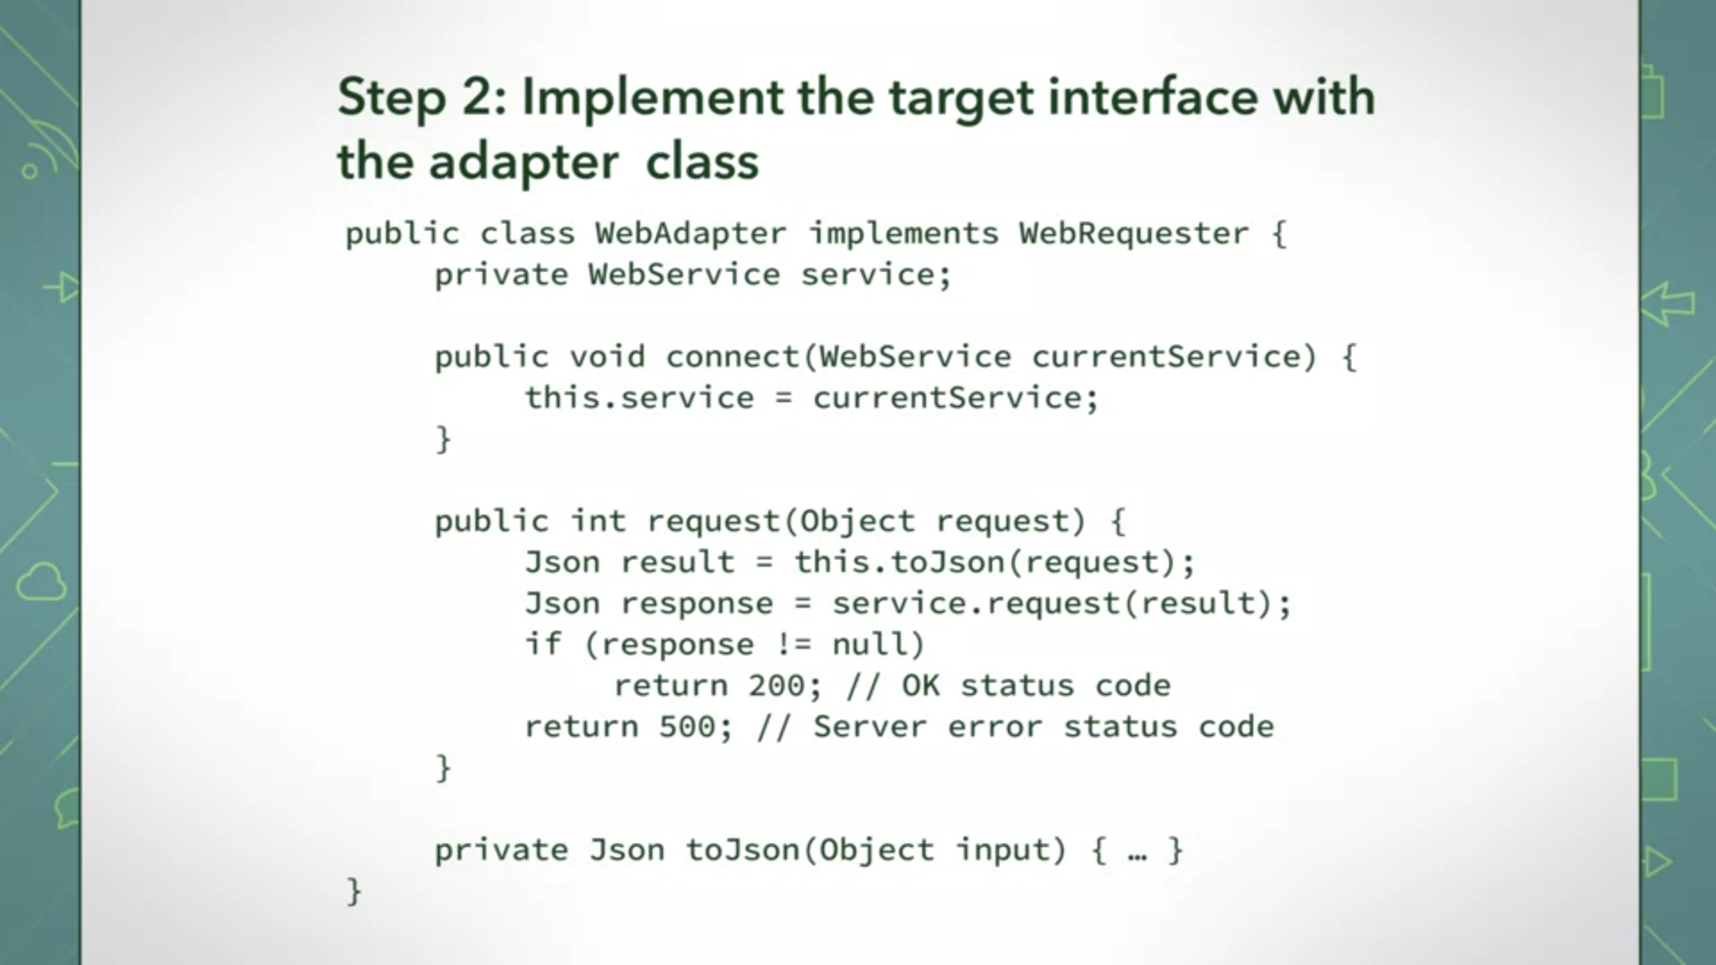

Slide 13
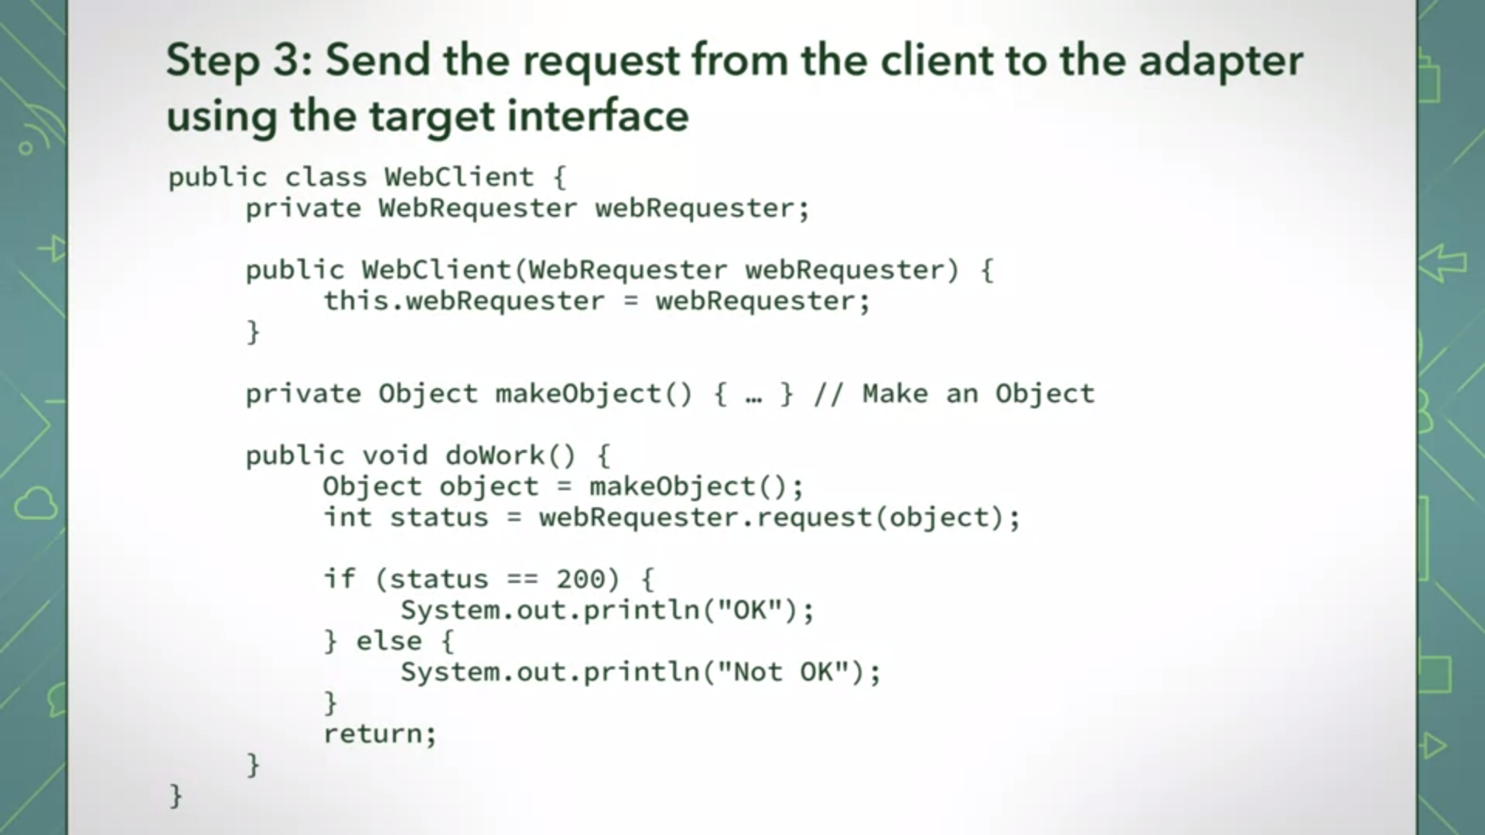

Slide 14
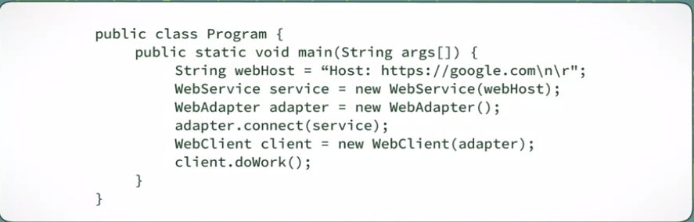

Slide 15
What are the characteristics of the adapter design pattern?
The client and adaptee classes have incompatible interfaces.
An adapter is a wrapper class that wraps the adaptee, hiding it from the client.
The client sends requests indirectly to the adaptee by using the adapter’s target interface.
The adapter translates the request sent by the client class into a request that the adaptee class is expecting.

Slide 16
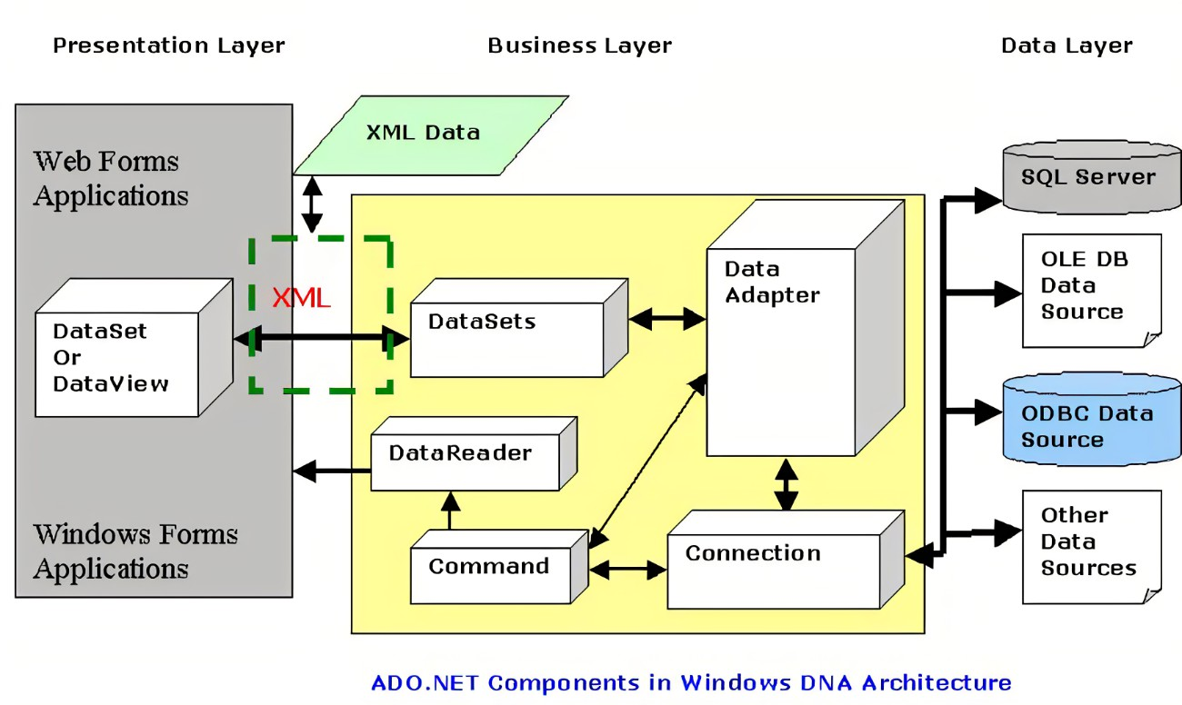
Database Connector

Slide 17
How is Facade different from the Adapter design pattern?

Slide 18
How is Facade different from the Adapter design pattern?
In the Adapter pattern, you are trying to alter an interface so that your clients do not see any difference between the interfaces.
By contrast, the Facade pattern simplifies the interface.
It presents the client with a simple interface to interact with (instead of a complex subsystem).

Slide 19
Adapter design needs more code. Do you agree?
You may need to write some additional code.
However, the payoff is great, particularly for those legacy systems that cannot be changed but you still want to use them for their stability

Slide 20
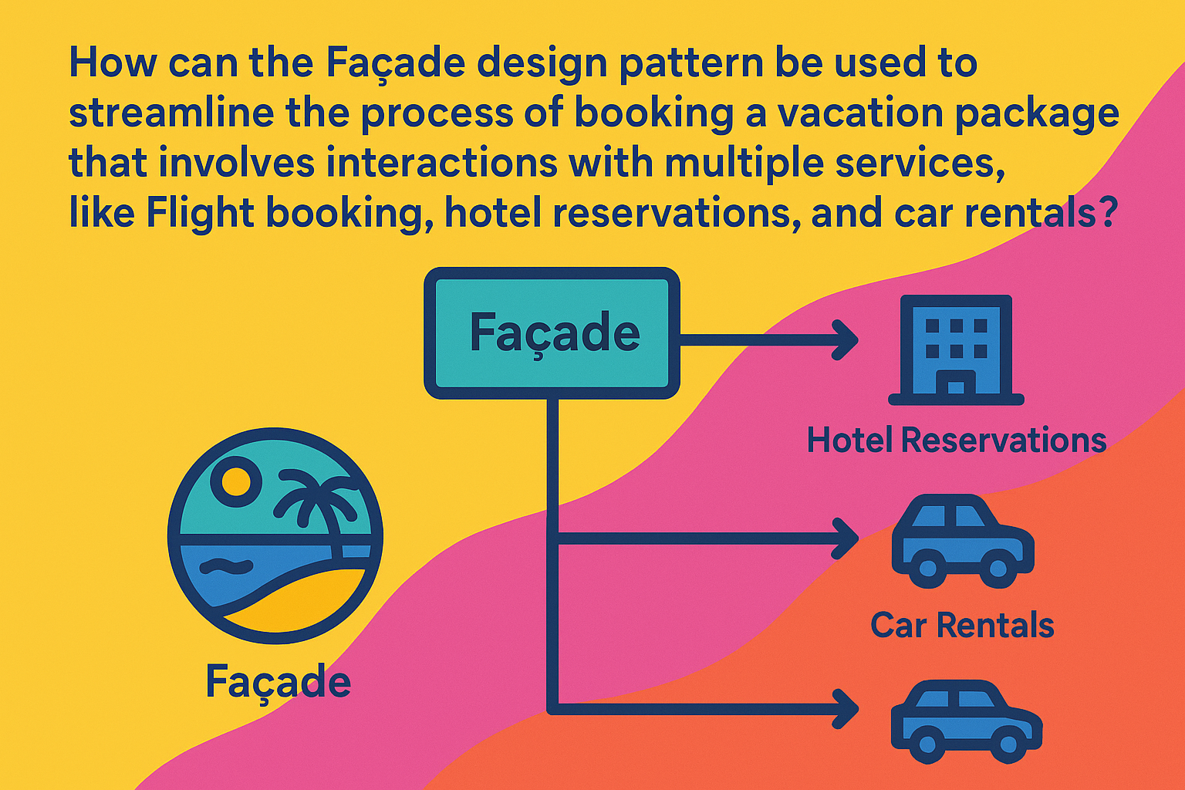
Real World Example

Slide 21
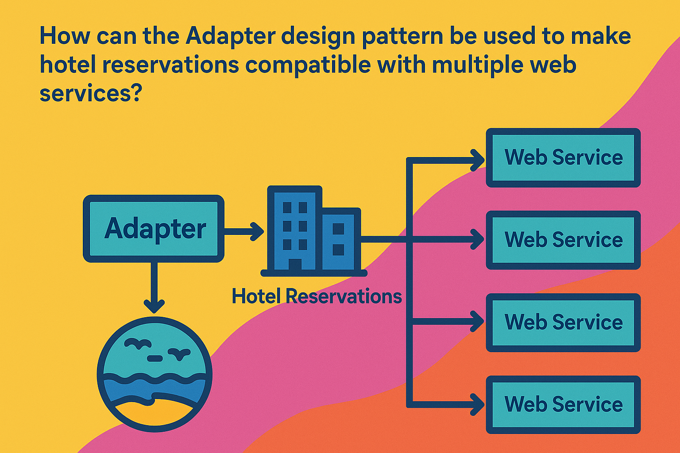

Slide 22
Case | Example
Home Theater System Controller | You bought a new sound system that uses Bluetooth commands, but your existing Home Theater Controller only supports infrared (IR).
Smart Home Automation | Your smart home hub works with Wi-Fi-based devices, but you purchased Zigbee-enabled light bulbs.
Banking System | The new loan approval module is built on a different API format than the old banking software.
Video Game Engine | A game engine uses its own graphics API, but you want to use a third-party physics engine with a different coordinate system and method naming.
Restaurant Online Ordering | The restaurant’s online ordering platform integrates with one type of payment gateway, but you now want to support PayPal.
Hospital Management System | A new insurance verification service uses XML-based requests, but your hospital system uses JSON.
E-Commerce Checkout Process | Your e-commerce platform integrates with a shipping provider’s API, but you switch to a new courier whose API uses different parameters and naming conventions.

Slide 23
Scenario | Facade Design Pattern – Simplifies interaction with multiple subsystems | Adapter Design Pattern – Converts one interface into another compatible interface
1. Home Theater System Controller | HomeTheaterFacade with watchMovie() method that turns on TV, sound, DVD, dims lights, and closes curtains in one step. | AudioSystemAdapter converts IR commands from the existing controller into Bluetooth commands for a new sound system.
2. Smart Home Automation | SmartHomeFacade with activateAwayMode() that locks doors, turns off lights, lowers thermostat, and arms security. | ZigbeeToWiFiAdapter converts hub’s Wi-Fi commands into Zigbee so incompatible smart bulbs work.
3. Banking System | LoanProcessingFacade with approveLoan() that runs credit checks, account verification, and document processing. | LoanModuleAdapter converts old banking system requests into the new loan module’s API format.
4. Video Game Engine | GameEngineFacade with startGame() that loads assets, initializes physics, sets UI, and connects to server. | PhysicsEngineAdapter maps game engine calls to a third-party physics engine with a different coordinate system/API.
5. Restaurant Online Ordering | OrderFacade with placeOrder() that handles menu check, payment, kitchen notification, and delivery dispatch. | PayPalAdapter lets the ordering platform use PayPal even though it was built for another payment gateway.
6. Hospital Management System | AdmissionFacade with admitPatient() that checks insurance, assigns a doctor, creates a file, and alerts the ward. | InsuranceServiceAdapter converts hospital’s JSON requests into XML for a new insurance service.
7. E-Commerce Checkout Process | CheckoutFacade with checkout() that verifies items, applies discounts, processes payment, and triggers shipping. | ShippingServiceAdapter converts platform’s shipping calls to match a new courier’s API format.

